Slide 1
Dataset
N.S.Manikandan
System Architect
TIFAC-CORE
VIT University
Vellore

Slide 2
What is a data set?
A data set is a collection of logically related data records stored on one disk storage volume or a set of volumes.
A data set can be:
  a source program
  a library of macros
  a file of data records used by a processing program.
You can print a data set or display it on a terminal. The logical record is the basic unit of information used by a program running on z/OS.

Slide 3
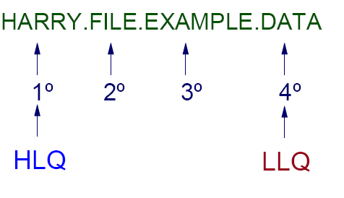
Dataset Naming
high level qualifier
low level qualifier

Slide 4
DASD: Use and terminology
Direct Access Storage Device (DASD) is another name for a disk drive.
DASD volumes are used for storing data and executable programs.
Data sets in a z/OS system are organized on DASD volumes.
  A disk drive contains cylinders
  Cylinders contain tracks
  Tracks contain data records.

Slide 5
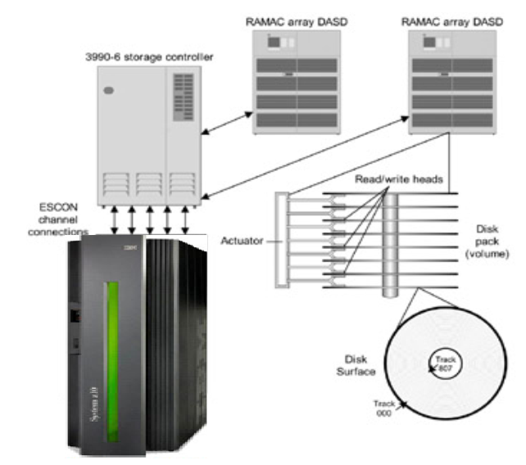
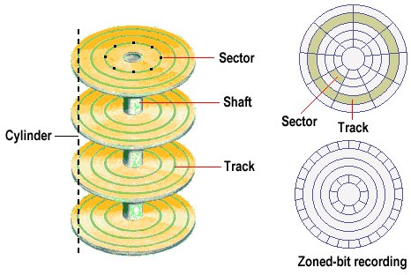
Direct access storage devices (DASD)

Slide 6
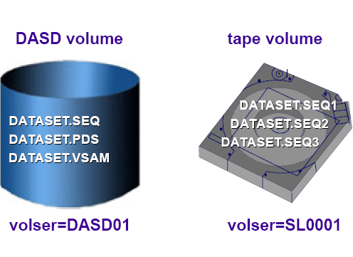
Datasets

Slide 7
Using a data set
To use a data set, you first allocate it. Then, access the data using macros for the access method that you have chosen.
Various ways to allocate a data set:
  ISPF data set panel, option 3.2
  TSO ALLOCATE command
  job control language (JCL)
Notes:
To use a data set, you first allocate it (establish a link to it), then access the data using
macros for the access method that you have chosen.
The allocation of a data set means either or both of two things:
To set aside (create) space for a new data set on a disk.
To establish a logical link between a job step and any data set.

Slide 8
Data set record formats
F
record
record
record
record
Fixed records.
block
block
FB
record
record
record
record
record
record
Fixed blocked records. BLKSIZE = n * LRECL
V
record
record
record
Variable records.
RDW
block
block
VB
record
record
record
record
record
BDW
Variable blocked records. BLKSIZE >= 4 + n * largest LRECL
U
record
record
record
record
Undefined records. No defined internal structure for access method.
Record and block descriptors words are each 4 bytes long
Notes:
Traditional z/OS data sets are record oriented. In normal usage, there are no byte stream
files such as are found in PC and UNIX systems. (z/OS UNIX has byte stream files, and
byte stream functions exist in other specialized areas. These are not considered to be
traditional data sets.)
In z/OS, there are no new line (NL) or carriage return and line feed (CR+LF) characters
to denote the end of a record. Records are either fixed length or variable length in a given
data set. When editing a data set with ISPF, for example, each line is a record.
Traditional z/OS data sets have one of five record formats, as shown on the slide. We must
stress the difference between a block and a record. In this discussion,
a block is what is written on disk, while a record is a logical entity.
F - Fixed This means that one physical block on disk is one logical
record and all the blocks/records are the same size. This
format is seldom used.
FB - Fixed Blocked This means that several logical records are combined into one
physical block. This can provide efficient space utilization and
operation. This format is commonly used for fixed-length
records.
V - Variable This format has one logical record as one physical block. The
application is required to insert a four-byte Record Descriptor
Word (RDW) at the beginning of the record. The RDW
contains the length of the record plus the four bytes for the
RDW. This format is seldom used.
VB - Variable Blocked This format places several variable-length logical records
(each with an RDW) in one physical block. The software must
place an additional Block Descriptor Word (BDW) at the
beginning of the block, containing the total length of the
block.
U - Undefined This format consists of variable-length physical
records/blocks with no predefined structure. Although this
format may appear attractive for many unusual applications, it
is normally used only for executable modules.

Slide 9
Types of data sets
We discuss three types in this class:
  Sequential, partitioned, and VSAM
A sequential data set is a collection of records written and read in sequential order from beginning to end.
A partitioned data set (PDS) is a collection of sequential data sets, called members.
  Consists of a directory and one or more members.
  Also called a library.
A PDSE is a partitioned data set extended.
Notes:
The simplest data structure in a z/OS system is a sequential data set. It consists of one or
more records that are stored in physical order and processed in sequence. New records
are appended to the end of the data set.
An example of a sequential data sets might be an output data set for a line printer or a
deck of punch cards.
A z/OS user defines sequential data sets through job control language (JCL) with a data
set organization of PS (DSORG=PS), which stands for physical sequential. In other
words, the records in the data set are physically arranged one after another.
A partitioned data set adds a layer of organization to the simple structure of sequential
data sets. A PDS is a collection of sequential data sets, called members. Each member is
like a sequential data set and has a simple name, which can be up to eight characters long.
A PDS also contains a directory. The directory contains an entry for each member in the
PDS with a reference (or pointer) to the member. Member names are listed alphabetically
in the directory, but members themselves can appear in any order in the library. The
directory allows the system to retrieve a particular member in the data set.
A partitioned data set is commonly referred to as a library.
A PDSE is a partitioned data set extended. It consists of a directory and zero or more
members, just like a PDS. It can be created with JCL, TSO/E, and ISPF, just like a PDS,
and can be processed with the same access methods. PDSE data sets are stored only on
DASD, not tape.

Slide 10
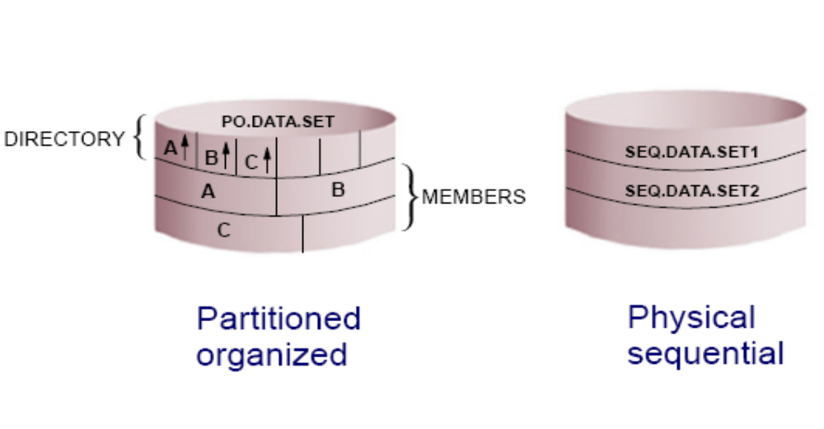
Types of Non-VSAM datasets

Slide 11
PDS versus PDSE
PDS data sets:
  Simple and efficient way to organize related groups of sequential files.
PDSE data sets:
  Similar to a PDS, but advantages include:
    Space reclaimed automatically when a member is deleted
    Flexible size
    Can be shared
    Faster directory searches
Notes:
A PDS data set offers a simple and efficient way to organize related groups of sequential
files. A PDS has the following advantages for z/OS users:
Grouping of related data sets under a single name makes z/OS data management
easier. Files stored as members of a PDS can be processed either individually or all
the members can be processed as a unit.
Because the space allocated for z/OS data sets always starts at a track boundary on
disk, using a PDS is a way to store more than one small data set on a track. This saves
you disk space if you have many data sets that are much smaller than a track. A track
is 56,664 bytes for 3390 disk device.
Members of a PDS can be used as sequential data sets, and they can be appended (or
concatenated) to sequential data sets.
Multiple PDS data sets can be concatenated to form large libraries.
PDS data sets are easy to create with JCL or ISPF; they are easy to manipulate with
ISPF utilities or TSO commands.
However, some aspects of the PDS
design affect both performance and the efficient use of disk storage, as follows:
Wasted space. When a member in a PDS is replaced, the new data area is written to a
new section within the storage allocated to the PDS. When a member is deleted, its
pointer is deleted too, so there is no mechanism to reuse its space.
Limited directory size. The size of a PDS directory is set at allocation time. As the
data set grows, it can acquire more space in units of the amount you specified as its
secondary space. These extra units are called secondary extents.
However, you can only store a fixed number of member entries in the PDS directory
because its size is fixed when the data set is allocated. If you need to store more
entries than there is space for, you have to allocate a new PDS with more directory
blocks and copy the members from the old data set into it.
Lengthy directory searches. Entries are searched sequentially in alphabetical order. If the directory is very
large and the members small, it might take longer to search the directory than to
retrieve the member when its location is found.
In many ways, a PDSE is similar to a PDS. Each member name can be eight bytes long.
For accessing a PDS directory or member, most PDSE interfaces are indistinguishable
from PDS interfaces. Both PDS and PDSE data sets are processed using the same access
methods (BSAM, QSAM, BPAM).
However, PDSE data sets have a different internal format, which gives them increased
usability. You can use a PDSE in place of a PDS to store data, or to store programs in the
form of program objects. A program object is similar to a load module in a PDS. A load
module cannot reside in a PDSE and be used as a load module. One PDSE cannot contain
a mixture of program objects and data members.
PDSE data sets have several features that can improve user productivity and system
performance. The main advantage of using a PDSE over a PDS is that a PDSE
automatically reuses space within the data set without the need for anyone to periodically
run a utility to reorganize it.
Also, the size of a PDS directory is fixed regardless of the number of members in it,
while the size of a PDSE directory is flexible and expands to fit the members stored in it.
Further, the system reclaims space automatically whenever a member is deleted or
replaced, and returns it to the pool of space available for allocation to other members of
the same PDSE. The space can be reused without having to do an IEBCOPY compress.

Slide 12
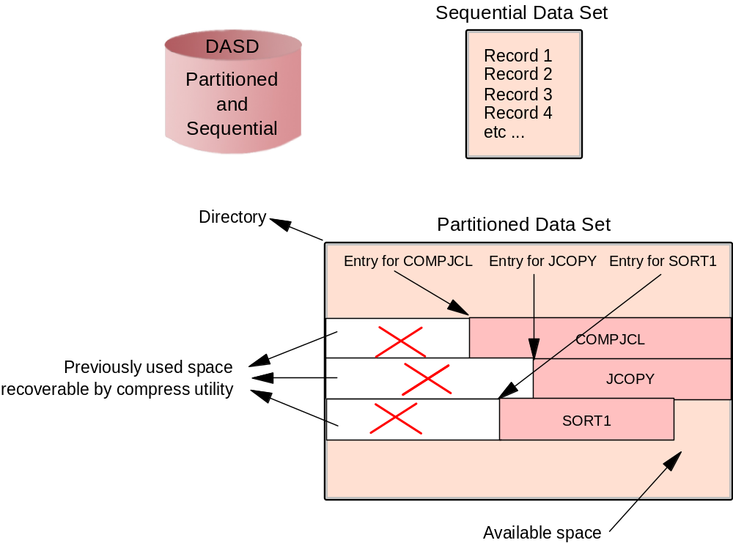
What is a data set, and how is it stored
Notes:
A data set is a collection of logically related data; it can be a source program, a library of
programs, or a file of data records used by a processing program. Data records are the
basic unit of information used by a processing program.
z/OS data sets are allocated in contiguous extents on a disk to enhance performance.
Users must define the amount of space to be allocated for a data set (before it is used). A
data set may occupy more than one extent and extents may be added dynamically.
Almost all z/OS data processing is record-oriented. Byte stream files are not present in
traditional processing, although they are a standard part of z/OS UNIX. z/OS records
(and physical blocks) are in one of several well-defined formats. Most data sets have
DCB attributes that include the record format (RECFM—F, FB, V, VB, U), the maximum
logical record length (LRECL), and the maximum block size (BLKSIZE).
When a member in a PDS is replaced, the new data area is written to a
new section within the storage allocated to the PDS. When a member is deleted, its
pointer is deleted too, so there is no mechanism to reuse its space. This wasted space
is often called gas and must be periodically removed by reorganizing the PDS, for
example, by using the utility IEBCOPY to compress it.

Slide 13
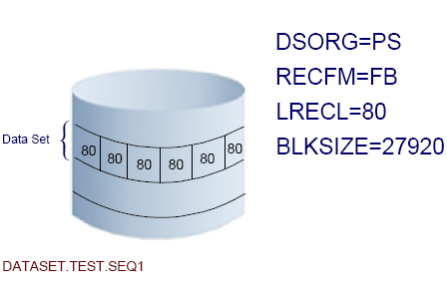
General Dataset Specifications

Slide 14
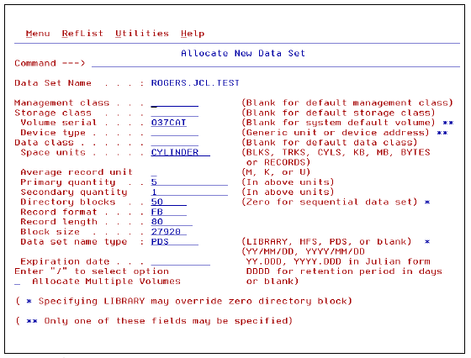
Allocating a Dataset in ISPF

Slide 15
How data sets are named
Data set naming convention
  Unique name
    Maximum 44 characters
  Maximum of 22 name segments: level qualifier
    The first name in the left: high level qualifier (HLQ)
    The last name in the right: low level qualifier (LLQ)
    Level qualifiers are separated by '.'
  Each level qualifier:
    From 1 up to 8 characters
    The first must be alphabetical (A-Z) or special (@ # $)
    The 7 remaining: alphabetical, national, numeric (0-9) or hyphen (-)
    Upper case only
  Example: MYID.JCL.FILE2 HLQ: MYID 3 qualifiers
Member name of partitioned data set
  8 bytes long
  First byte: alphabetical (A-Z) or special (@ # $)
  The 7 remaining: alphabetical, special, numeric (0-9)
Notes:
When you allocate a new data set (or when the operating system does), you must give the
data set a unique name.
A data set name can be one name segment, or a series of joined name segments. Each
name segment represents a level of qualification. For example, the data set name
VERA.LUZ.DATA is composed of three name segments. The first name on the left is
called the high-level qualifier (HLQ), the last name on the right is the lowest-level
qualifier (LLQ).
Segments or qualifiers are limited to eight characters, the first of which must be
alphabetic (A to Z) or special (# @ $). The remaining seven characters are either
alphabetic, numeric (0 - 9), special, a hyphen (-). Name segments are separated by a
period (.).

Slide 16
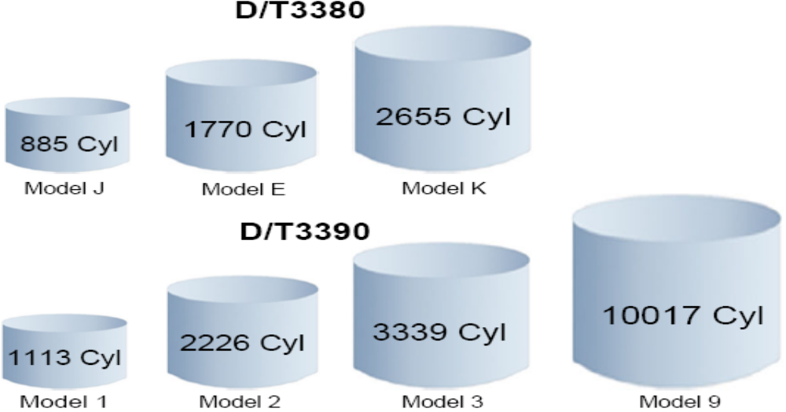
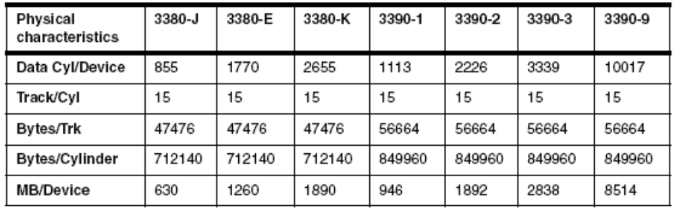
Traditional Disk Capacity (DASD)

Slide 17
VSAM
VSAM is Virtual Storage Access Method
VSAM provides more complex functions than other disk access methods
VSAM record formats:
  Key Sequence Data Set (KSDS)
  Entry Sequence Data Set (ESDS)
  Relative Record Data Set (RRDS)
  Linear Data Set (LDS)
Notes:
The term Virtual Storage Access Method (VSAM) applies to both a data set type and the
access method used to manage various user data types.
As an access method, VSAM provides much more complex functions than other disk
access methods. VSAM keeps disk records in a unique format that is not understandable
by other access methods.
VSAM is primarily for applications. It is not used for source programs, JCL, or
executable modules. VSAM files cannot be routinely displayed or edited with ISPF.
You can use VSAM to organize records into four types of data sets: key-sequenced,
entry-sequenced, linear, or relative record. The primary difference among these types of
data sets is the way their records are stored and accessed.

Slide 18
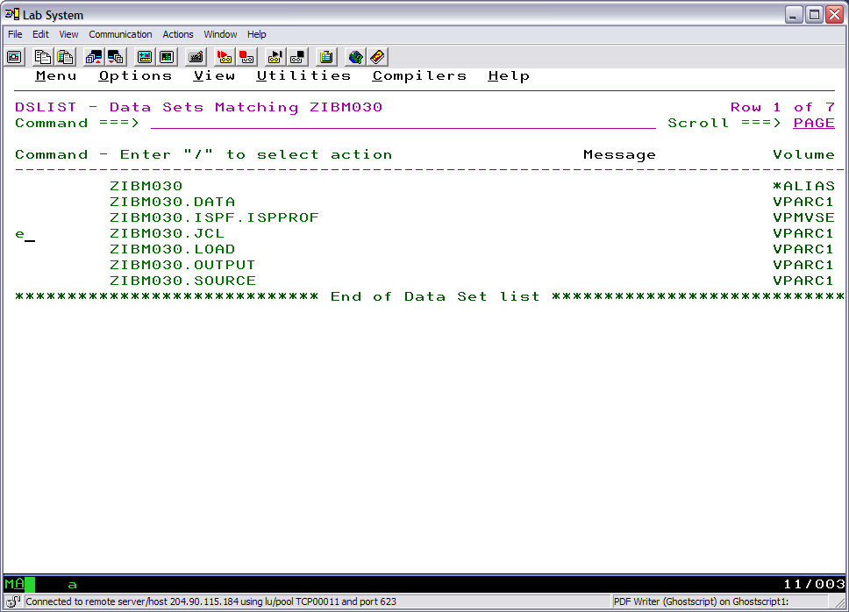
ISPF Editor – s (select) EDITTEST to edit this JCL member

Slide 19
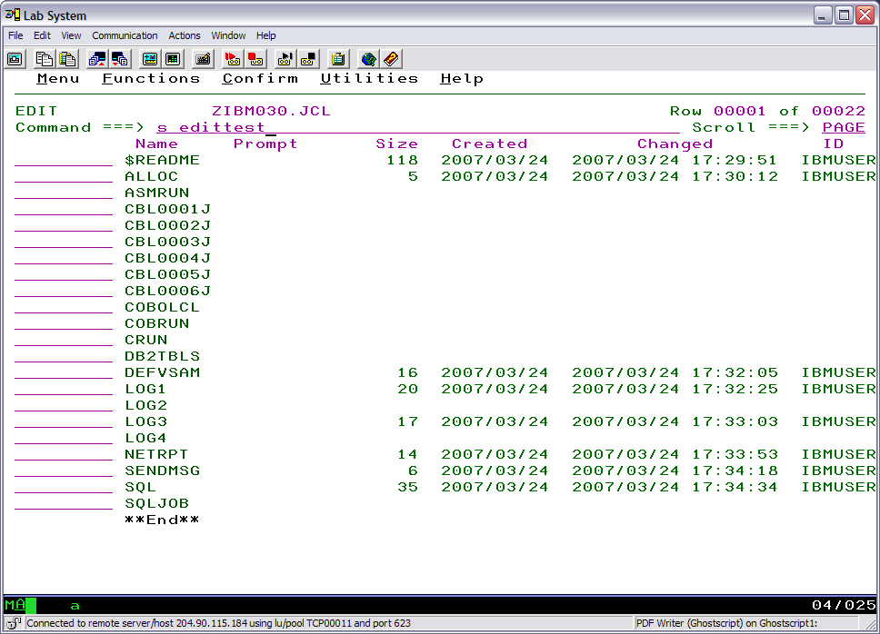
ISPF Editor – s (select) edittest

Slide 20
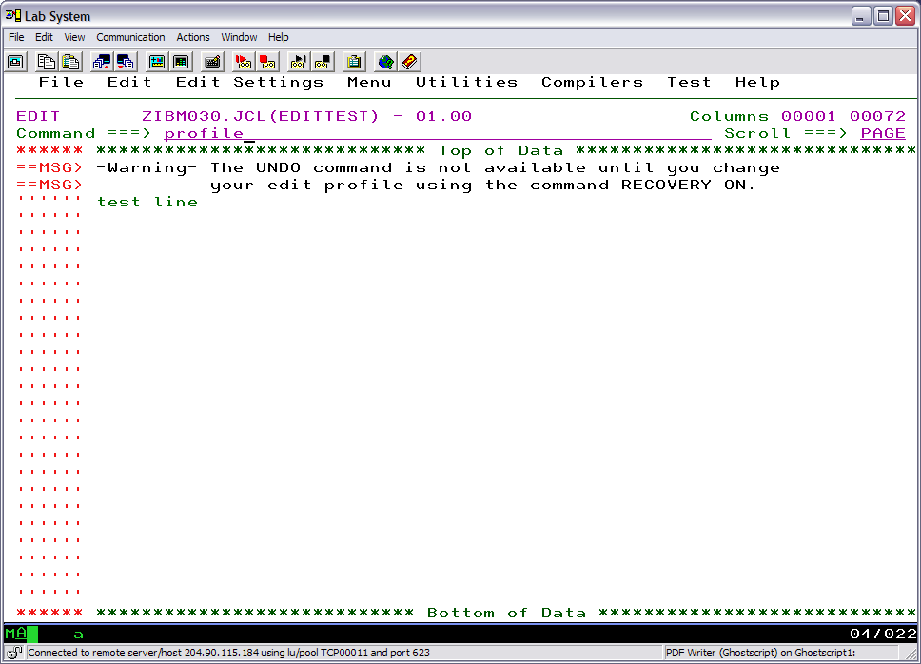
ISPF Editor – ‘profile’ will display current edit profile settings

Slide 21
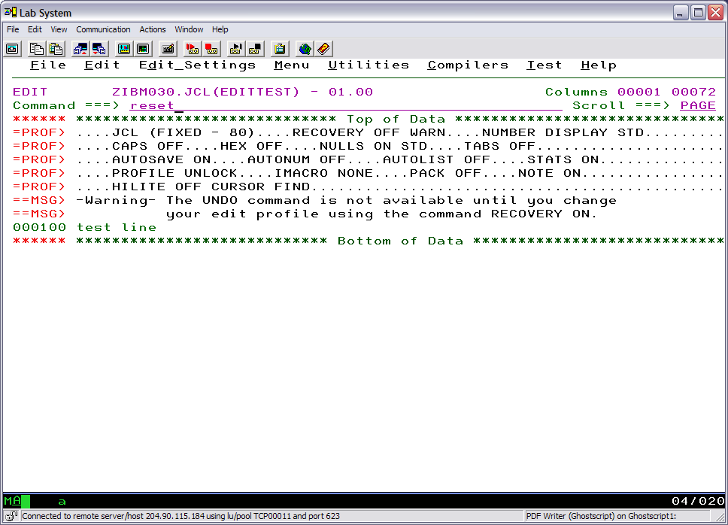
ISPF Editor – ‘reset’ to suppress messages, etc.

Slide 22
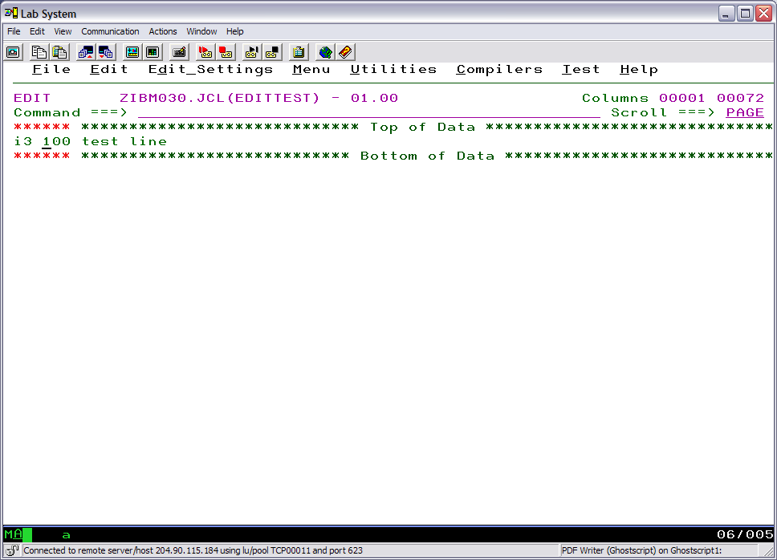
ISPF Edit – insert 3 lines line command i3

Slide 23
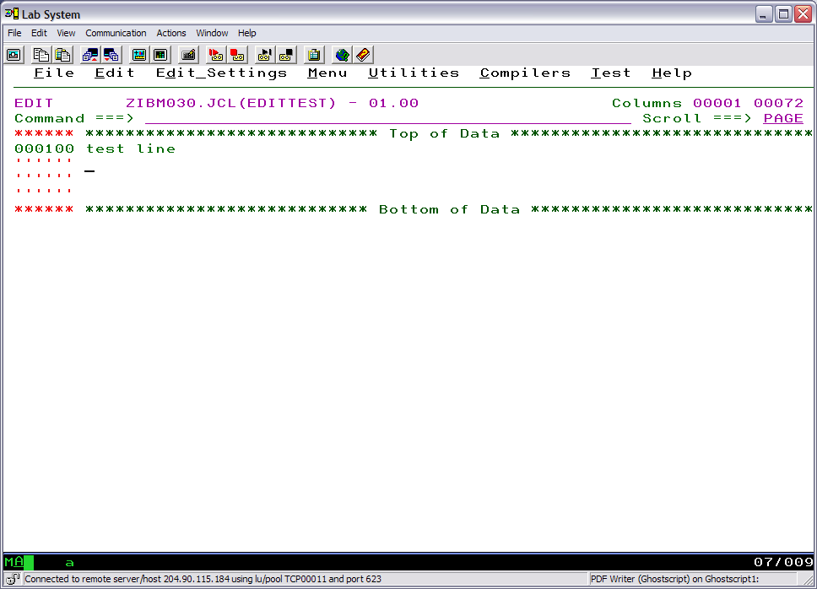
ISPF Edit –data typed into new lines followed by <enter>

Slide 24
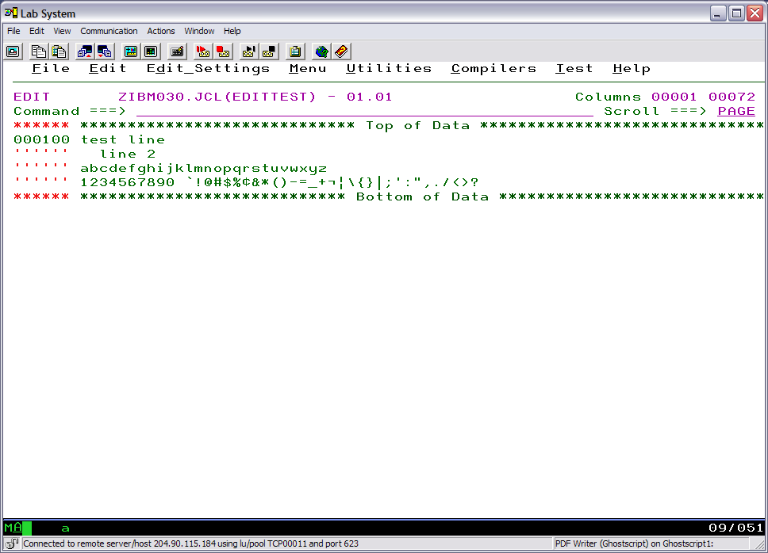
ISPF Editor – <enter> key after data is typed into new lines

Slide 25
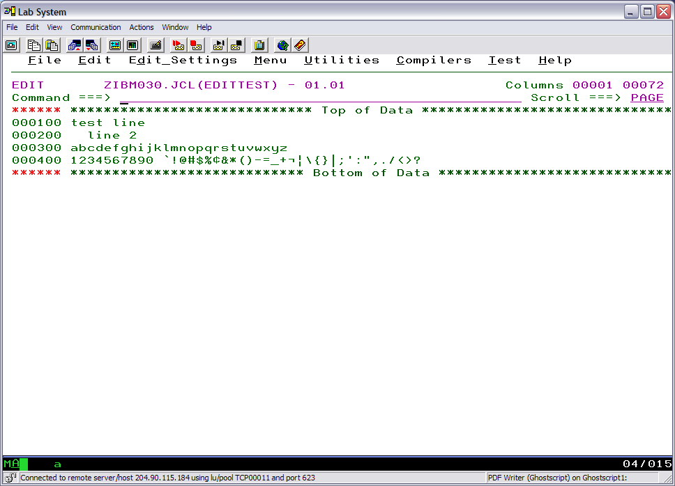
ISPF Editor – <enter> key after data is typed into new lines

Slide 26
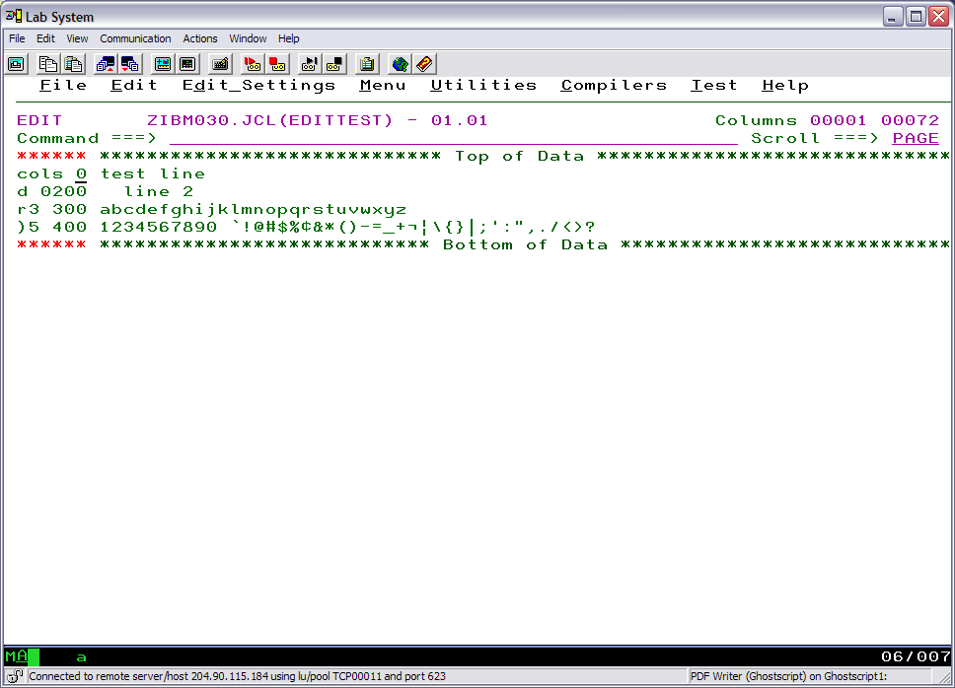
ISPF Edit – line commands

Slide 27
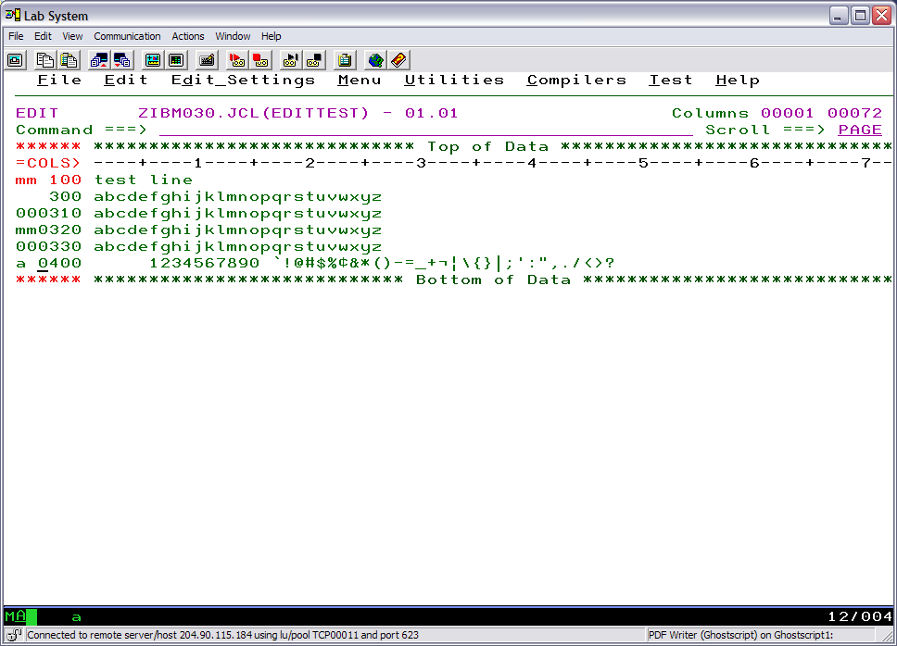
ISPF Edit – line commands

Slide 28
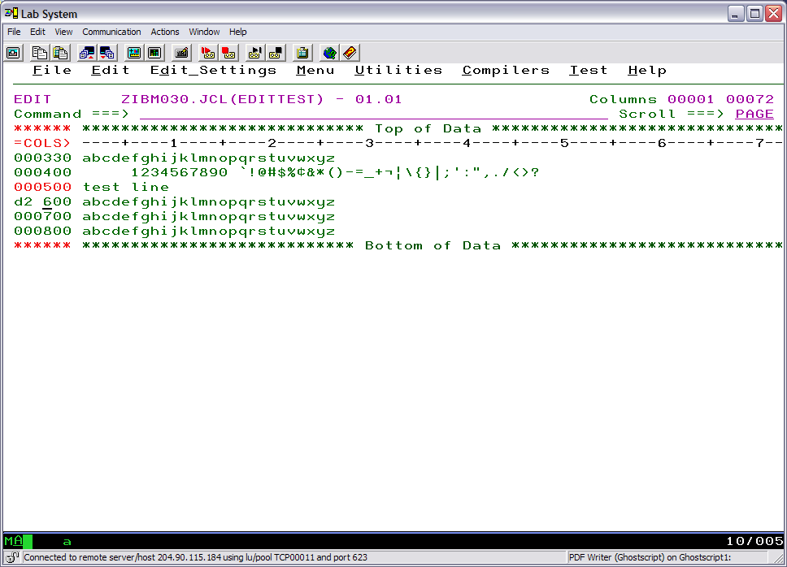
ISPF Edit – line commands

Slide 29
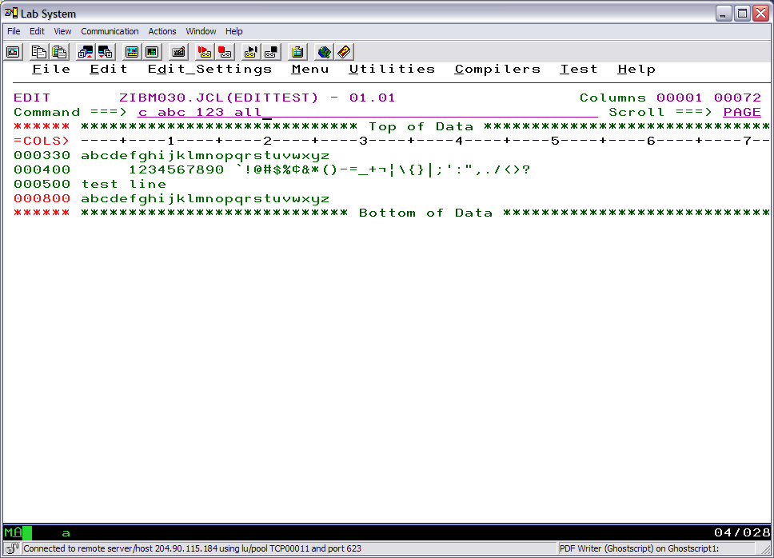
ISPF Edit – primary commands

Slide 30
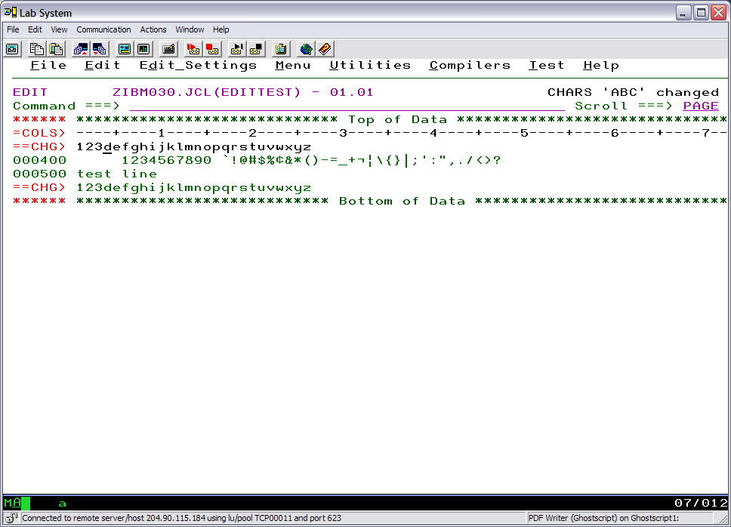
ISPF Edit – primary commands

Slide 31
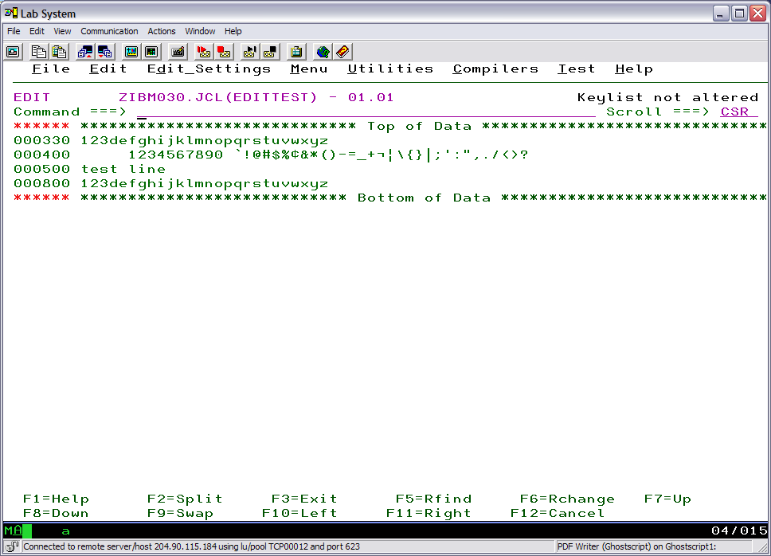
ISPF Edit – Function Keys
keys …. primary command to modify

Slide 32
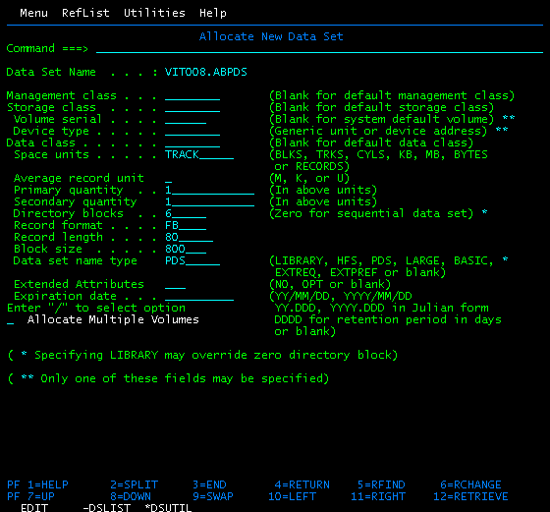
Allocate New Data Set panel
Notes:
*Now you see the Allocate New Data Set panel . This panel is almost identical to the Data Set Information panel you saw earlier . the main
difference is that you can update the various parameters displayed, preparatory to actually allocating the data set.
Make any changes you wish to the values shown, and then press<Enter> to allocate the data set. ISPF returns you to the Data Set Utility panel.

